Slide 1
Plant Disease Identification with Keras
Michaella Phillips

Slide 2
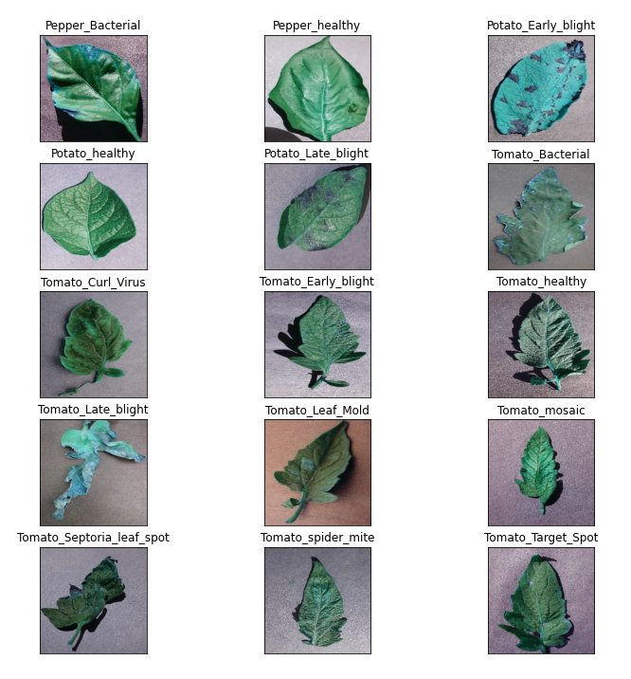
Plant Diseases
Plants and crops are susceptible to many diseases that can lead to crop failure.
Including:
Bacterial infections
Blight
Septoria leaf spot
Spider mites
Mold
Mosaic Viruses

Slide 3
Importance of Identification
Not all diseases can be treated the same way.
Some can spread to other crops/plants.
Factors causing these issues can include:
Bad soil
Poor ventilation
Lack of pesticides or pest prevention methods

Slide 4
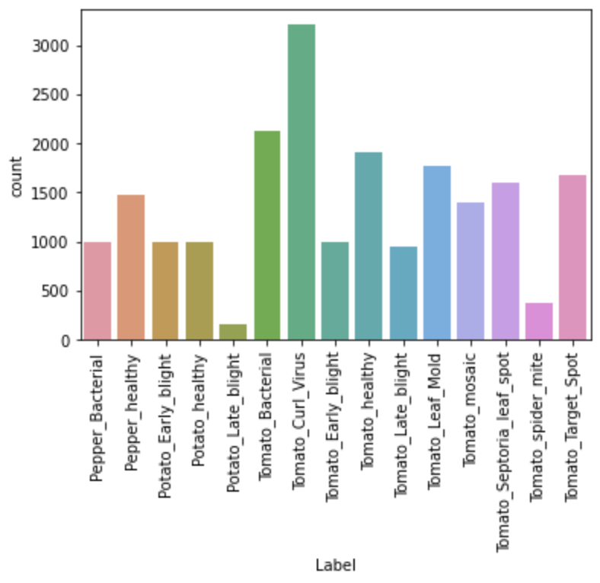
The Data
The data was collected from: https://www.kaggle.com/emmarex/plantdisease
There are 15 classes with uneven distribution of images.
Could cause issues with the model

Slide 5
Building the Model: Splitting the Data
The data was randomly sorted and 5 images were set aside for testing.
Split (80/20) into Train and Validation sets.

Slide 6
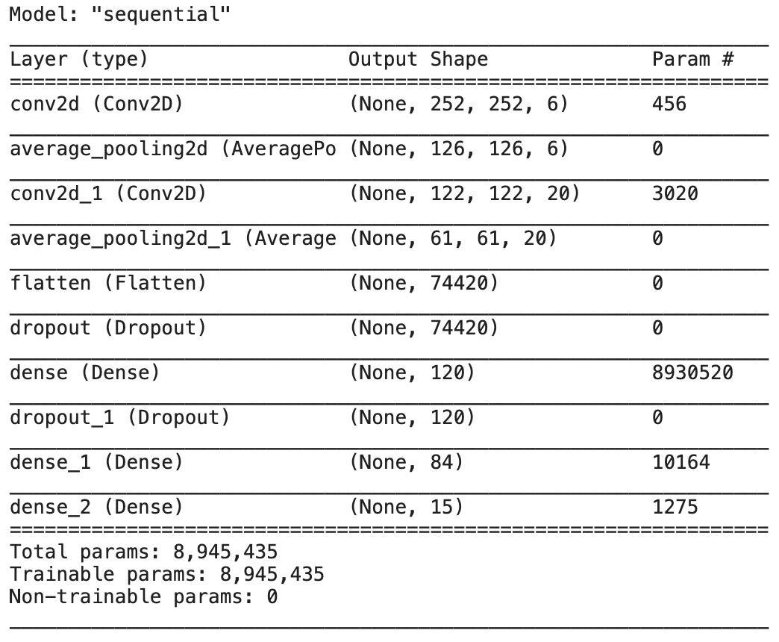
Building the Model: LeNet
The model architecture used was LeNet.
Two drop out statements were used with a 0.2 probability each.
Batch Size: 32
Epoch: 15

Slide 7
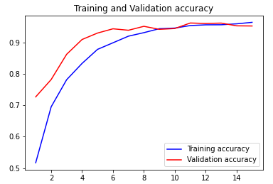
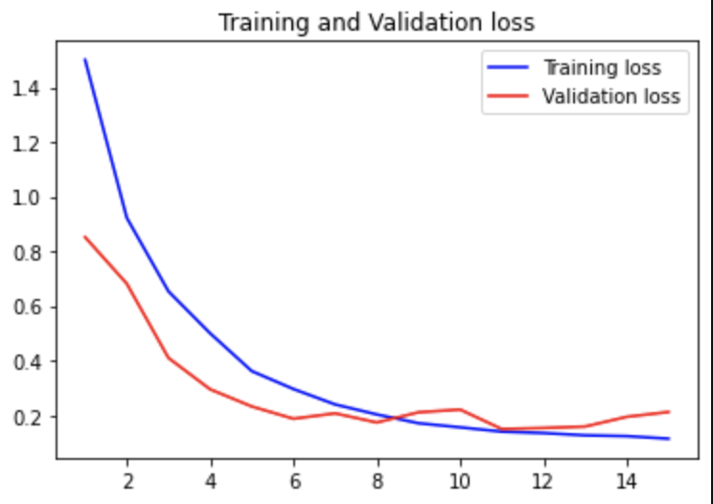
Model Evaluation
Training accuracy approaches 1, while loss approaches 0.1.
Weighted precision: 0.95
F1 Score: 0.95

Slide 8
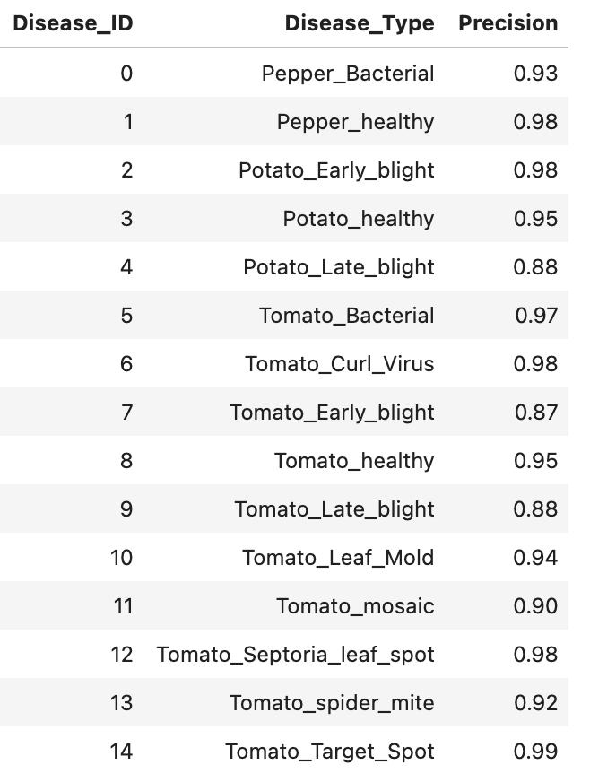
Model evaluation
The precision was over 0.9 for most of the diseases excluding the potato late blight, tomato early blight, and tomato late blight. These had lower amounts of images excluding the tomato late blight.

Slide 9
Future Work on Model
The model could be improved by using a method to normalize the distribution of the images taken for validation and training.
I.e. imbalanced-learn
Increasing epochs to 30. It was clear the model did not finish its approach to 1. This means I should have used more epochs.
Image distortion or increase in image styles.
Model could benefit from a variety of backgrounds, image styles, and distortions instead of a single leaf on a plain background. This would aid in making it true to life.

Slide 10
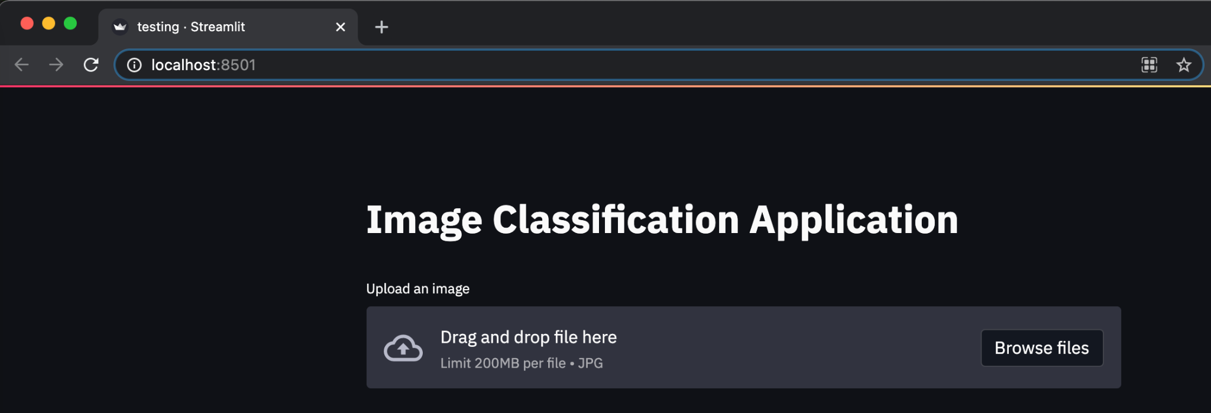
Stretch Goal: Application
Development of a simple web application was made using Streamlit.

Slide 11
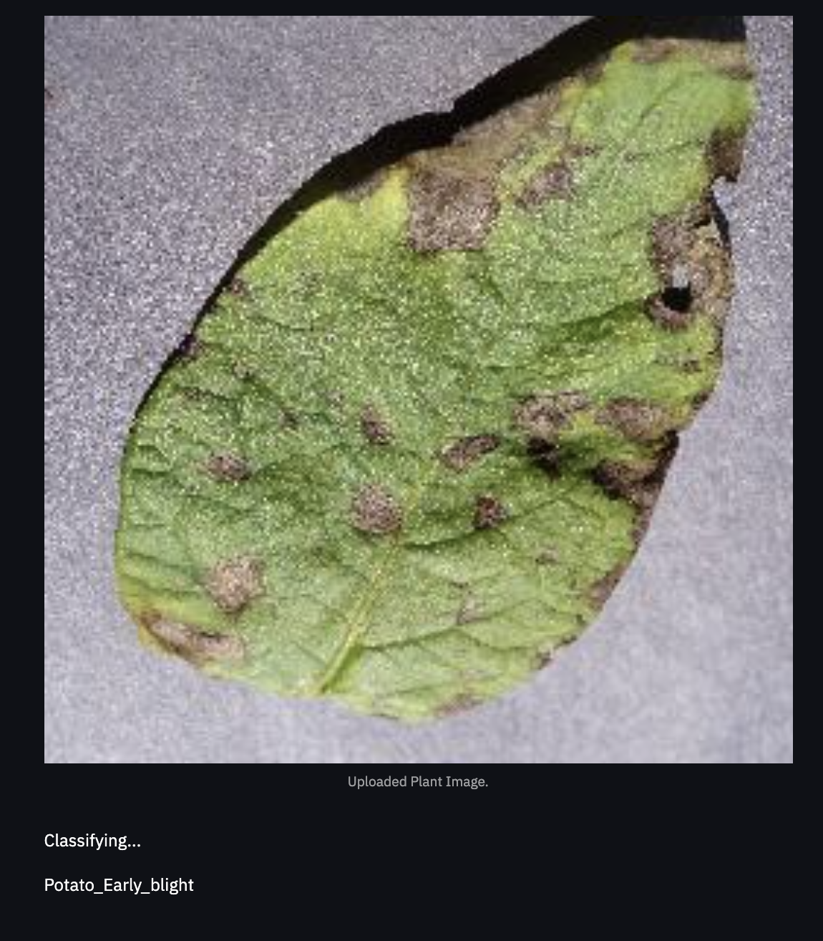
The Application and Test
Dragging and dropping the photo into the app correctly identified this image of Potato Early blight.

Slide 12
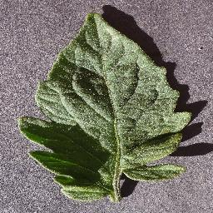
Healthy
This image was incorrectly identified as Tomato_Septoria_leaf_spot. I assume the shadows distorted it.

Slide 13
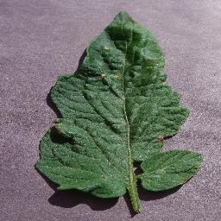
Target Spot
This image was correctly identified as Tomato_Target_Spot

Slide 14
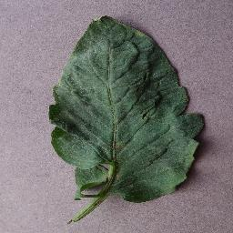
Target Spot 2
This image was incorrectly identified as Tomato_Leaf_Mold. Both target spot and leaf mold present with spots that are visually very similar.

Slide 15
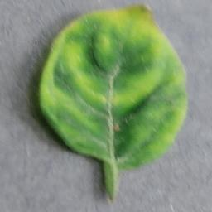
Curl Virus
This image was correctly identified as Tomato_Curl_Virus.

